Slide 1
Key population-led health services (KP-LHS) critical to PrEP introduction among men who have sex with men (MSM) and transgender women (TGW) in Thailand
Ravipa Vannakit, USAID Regional Development Mission for Asia (RDMA), Bangkok, Thailand
July 24, 2018
rvannakit@usaid.gov

Slide 2
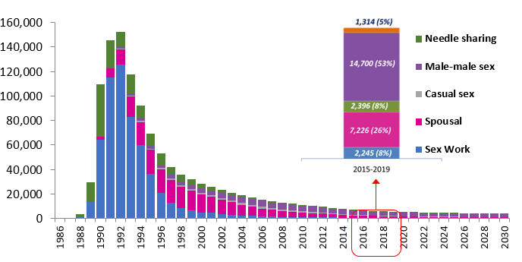
PrEP in Thailand: who needs it?
Estimated number of new HIV infections among adults ≥15 years in Thailand
Thailand has a concentrated HIV epidemic, with men who have sex with men (MSM) estimated to comprise over half of new HIV infections
They are thus a prime focus for PrEP scale-up

Slide 3
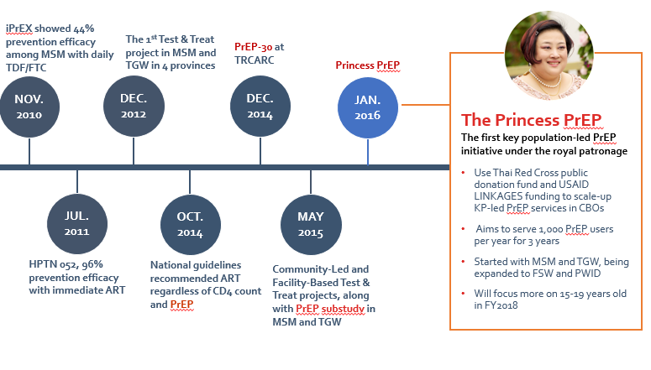
Evolution of PreP in Thailand
Thailand involved in early PrEP development
National guidelines for PrEP 4 years later
PreP-30 (about US$ 1 per PrEP dose) starts at Thai Red Cross AIDS Research Centre (TRCARC)
PEPFAR Implementation science in community and government clinics
  USAID LINKAGES and Thai Princess support PreP scale-up through key population-led health services in 2016 (free PrEP)
Source: Thai Red Cross AIDS Research Centre

Slide 4
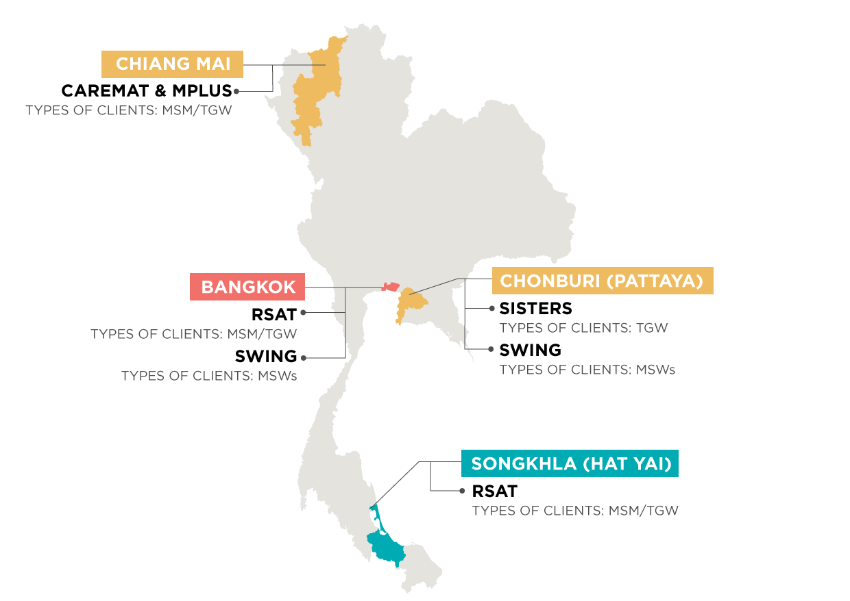
Key population-led health services (KP-LHS) in Thailand: early adopters of innovations, e.g. PrEP
7 KP-LHS organizations in provinces in Thailand are
“learning lab” for many innovations and new approaches in the HIV cascade
  Enhanced peer mobilization (EPM)
  Community-based HIV testing and ART
  Oral-fluids HIV screening and self-testing
  PrEP
Active partners in research that provides on-going evidence of innovation effectiveness and implementation led by KP-LHS

Slide 5
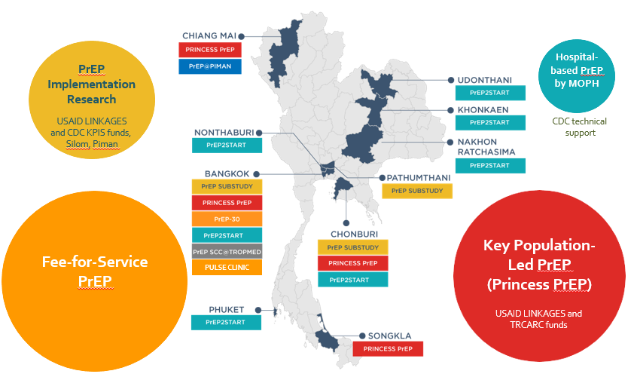
Thailand’s PrEP programs as of June 2018
Source: Thai Red Cross AIDS Research Centre

Slide 6
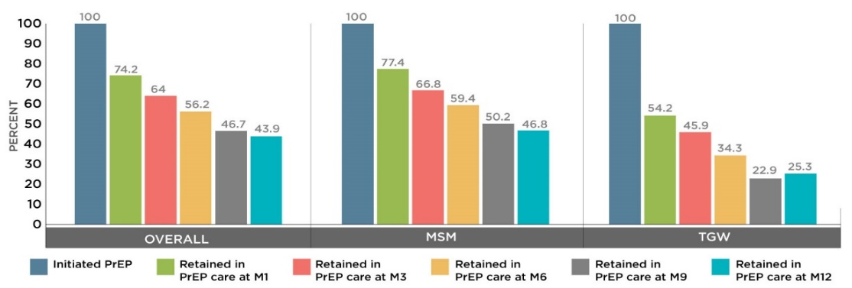
PrEP research in partnership with KP-LHS
Data and evidence on characteristics of PrEP acceptors, adherence, etc.
Characteristics | Overall (N=1,697) | MSM (n=1,467) | TGW (n=230) | P-value
1. Demographic data
Age (years: Mean (SD) | 28.8 (7.2) | 29.2 (7.4) | 26.1 (5.7) | <0.001ª
Thai Nationality (n(%) | 1,616 (95.2) | 1,406 (95.8) | 210 (91.3) | -
Education less than bachelor degree (n(%) | 578 (34.1) | 427 (29.1) | 151 (65.7) | <0.001^{c}
Main occupation as Sex worker (n(%) | 175 (10.3) | 99 (6.8) | 76 (33) | <0.001^{c}
2. Risk characteristics at baseline
First sexual intercourse < 18 years (n(%) | 548 (32.3) | 442 (30.1) | 106 (46.1) | <0.001^{c}
Male circumcision (n(%) | 242 (14.3) | 228 (15.5) | 14 (6.1) | 0.002^{c}
Self-perceived having moderate/high risk of HIV infection in the past 3 months | 793 (46.7) | 677 (46.2) | 116 (50.4) | 0.30^{c}
Having multiple partners in the past 3 months | 1,085 (63.9) | 929 (63.3) | 156 (67.8) | 0.003^{c}
Had group sex in the past 3 months | 358(21.1) | 315(21.5) | 43(18.7) | 0.57^{c}
Condomless in the past 3 months | 749 (44.1) | 641 (43.7) | 108 (47) | 0.16^{c}
Drug/stimulant use in the past 3 months | 557 (32.8) | 495 (33.7) | 62 (27) | 0.04^{c}
Amphetamine-type stimulant use | 105 (6.2) | 97 (6.6) | 8 (3.5) | 0.06^{c}
Data suggests that KP-LHS organizations are reaching high-risk individuals in need of PrEP, e.g. high rates of drug/stimulant use, group sex
Data indicate 43.9% adherence after 12 months; Transgender women show much lower adherence at 25.3%
Source: Thai Red Cross AIDS Research Centre/ USAID LINKAGES Project

Slide 7
PrEP scale-up in Thailand: 2014-2018
Numerous government and non-government organizations are now involved in PrEP scale-up
KP-LHS account for about 50% of PrEP scale-up
BUT STILL NOT ENOUGH → NO HERD EFFECT TO
AVERT HIV INFECTIONS
IN THE COMMUNITY!!!

Slide 8



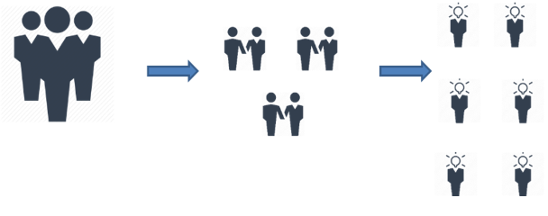
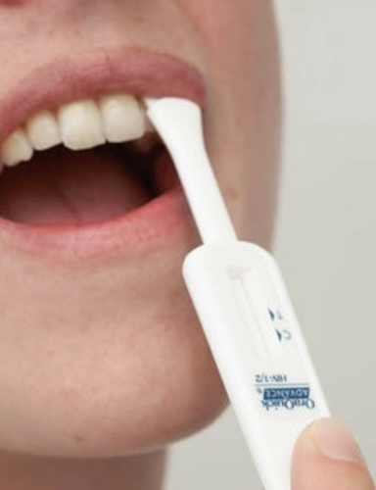
Improved and faster PrEP scale-up necessitates better demand creation, outreach, and HIV testing
Demand creation: social media, crowd-sourcing
Outreach: use of peer mobilizers, on-line outreach
HIV testing – making it easier
  oral fluids screening, HIV self-testing

Slide 9
Conclusions and future plans for PrEP in Thailand
KP-LHS organizations are critical for rapid PrEP scale-up, particularly where epidemic growth is concentrated among KPs
Data suggest that in the early stages of introduction, KP-LHS can quickly add new products such as PrEP and obtain high uptake through their trusted relationships with KPs
PrEP to be supported by National Health Security Organization (NHSO) in Thailand later this year as part of universal health coverage
Advocacy on establishing national targets still needed
More demand creation among young MSM and TGW is critical to addressing the needs of this high-incidence population

Slide 10











Acknowledgements

